Slide 1
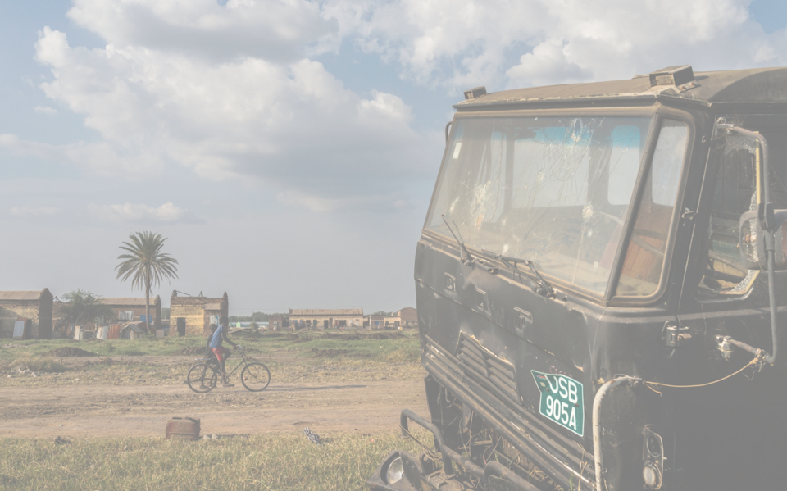
MSF - UBC
Essential Surgical Skills Curriculum
A partnership to build capacity in surgical care in the lowest resource settings
Dr. Emilie Joos Trauma and Acute Care Surgeon Vancouver General Hospital
Notes:
First, I would like to thank Stu and the organizers of this conference for inviting Phil and I to your meeting. It is an honor to be part of this dynamic and passionate group of people. I strongly believe that the way to maintain surgical capacity in remote Canada is through formal partnerships between our professional bodies, like CAGS and TAC and the society of rural physicians of canada. We need you, and you need us. By joining forces, we can share knowledge, skills and resources and build cost-effective high quality surgical programs across the country. It does not have to be siloed. What Vikki and Phil are doing in Revelstoke can and should be replicated in BC and in all provinces in Canada. So thank you for fostering our friendship and we are looking forward to a lifelong collaboration.

Slide 2
Outline
The need
The actors
The concept
The application
The pitfalls
Outlook

Slide 3
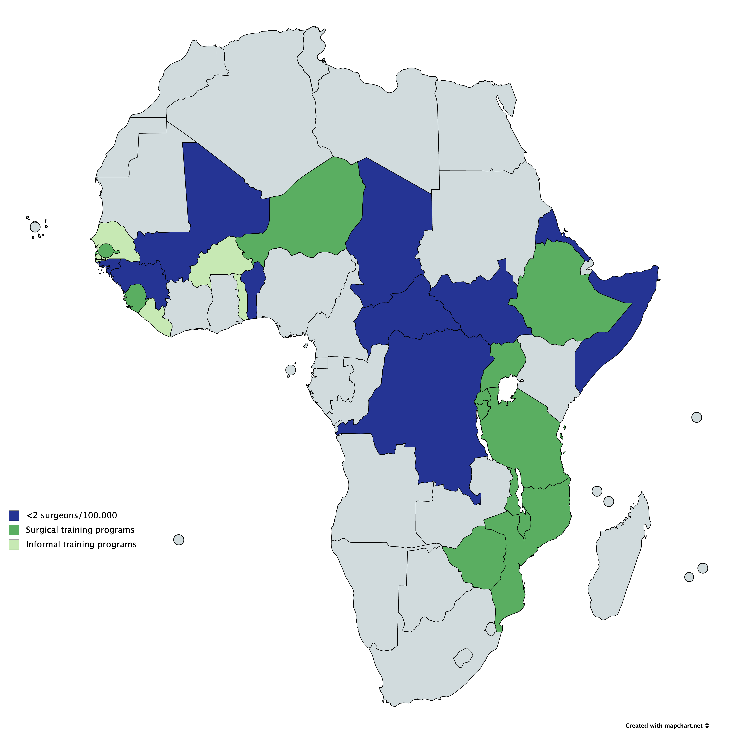
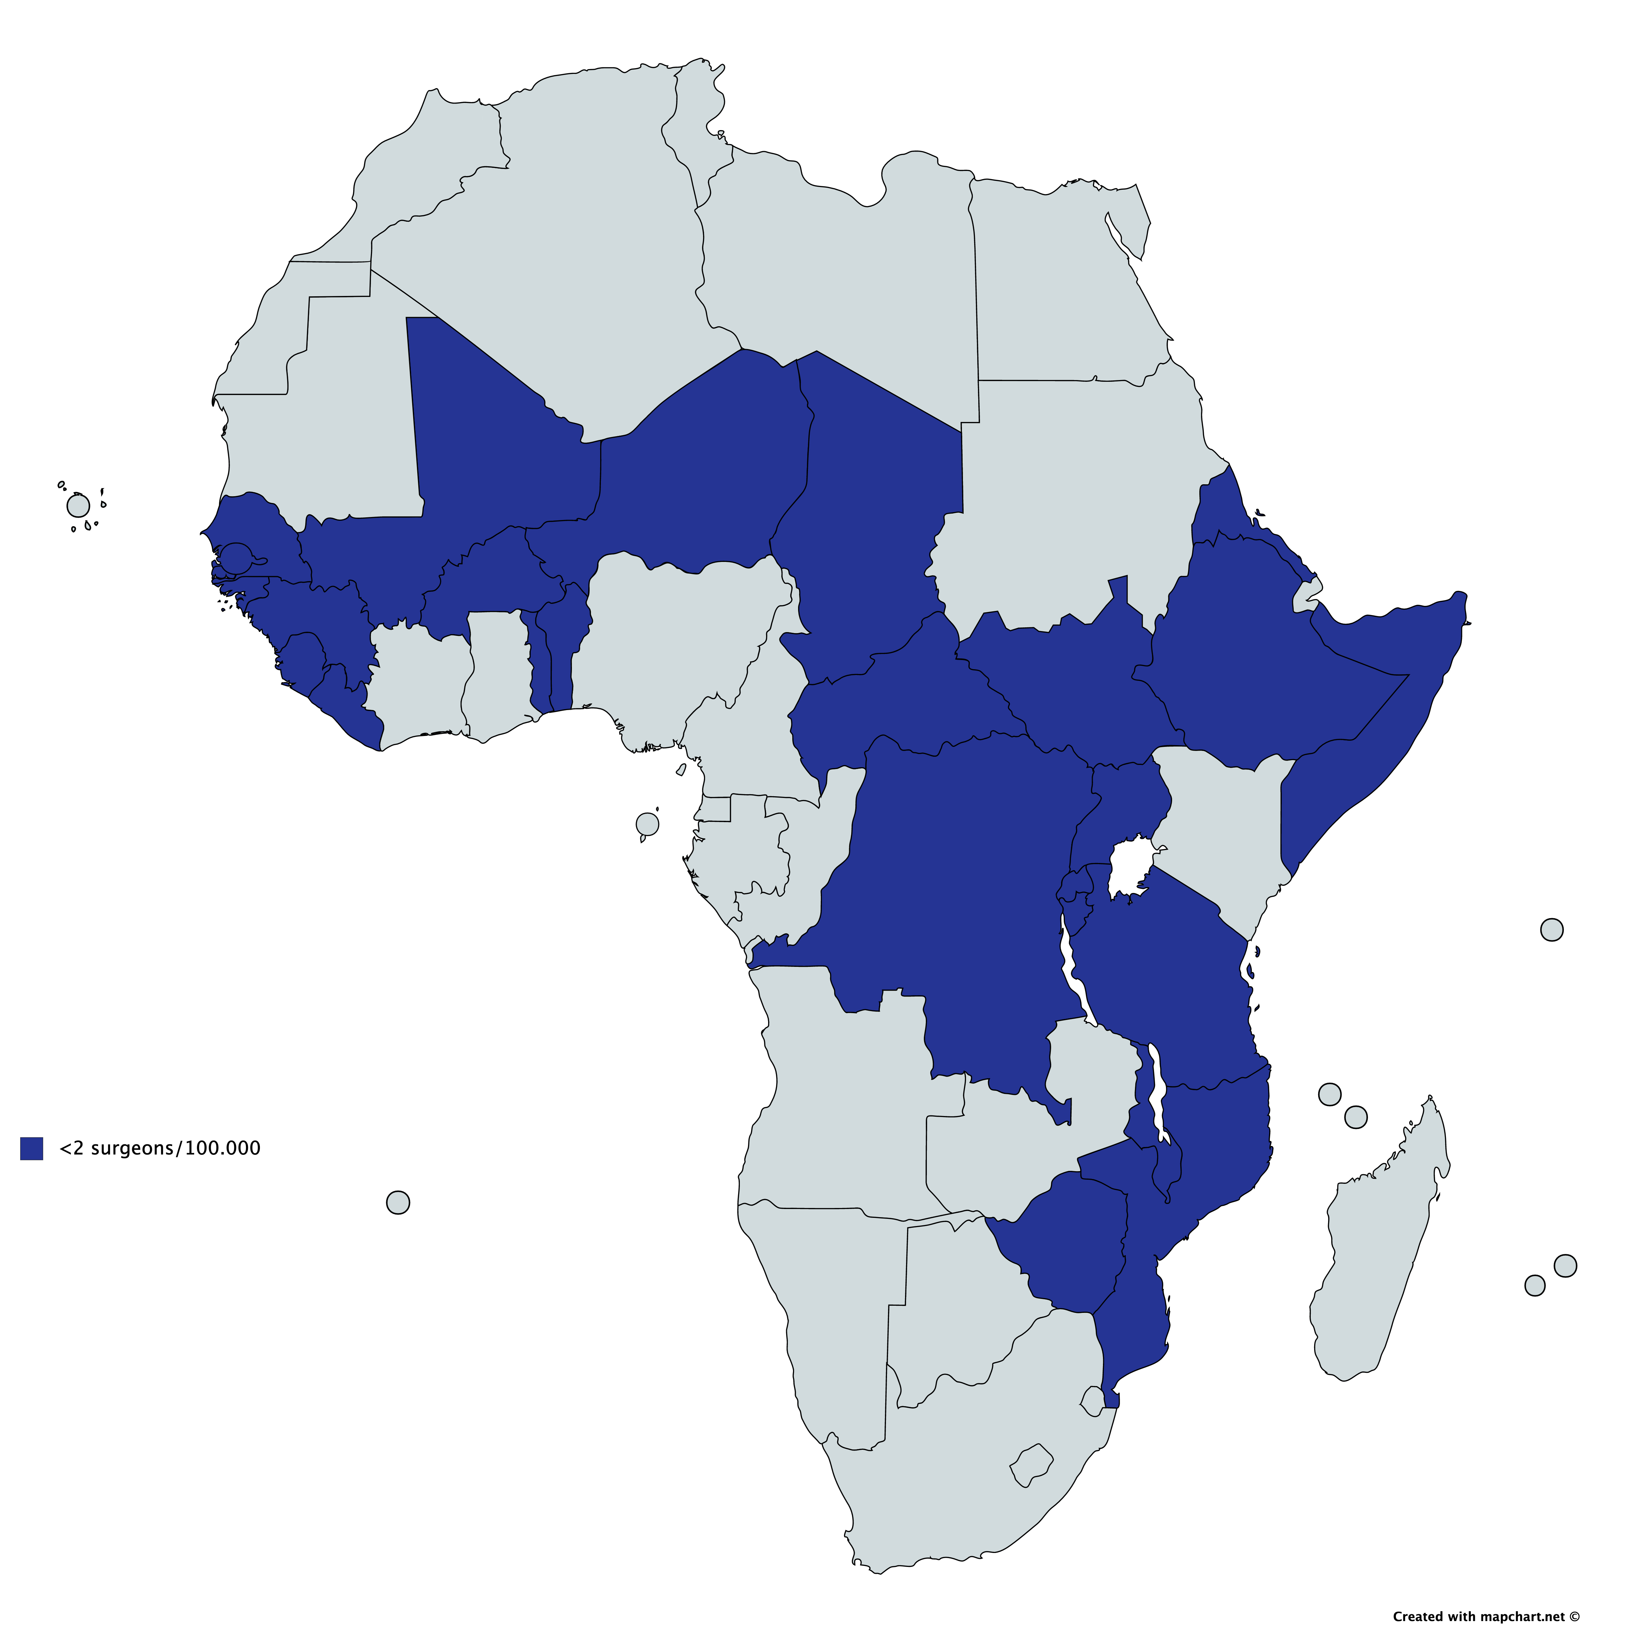
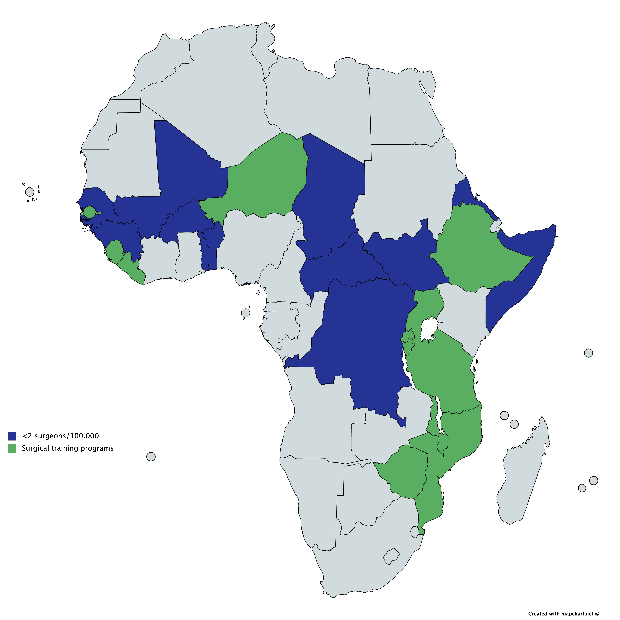
The need
Notes:
93% of the unmet surgical need in the world is in SSA = 40 million surgical procedures needed annually to provide essential surgical care
One of the major obstacle to delivering surgical care is the absence of surgical providers
Total 25 SSA LIC. 11 have formal training programs. 4 have informal task-shifting task sharing.

Slide 4
MSF
presence in
SSA
Notes:
MSF has surgical projects in 7 countries where there are very few surgeons and no training opportunities. As you can imagine, MSF being a humanitarian organization and not a development agency, they need to close projects so that they can open new ones where there are emergencies. But the challenge is handing over surgical services when there are no local surgeons.
Total 25 SSA LIC. 11 have formal training programs. 4 have informal task-shifting task sharing. Out of th 10 left, MSF has surgical projects in 7 of them: mali, benin, chad, CAR, SS, DRC, erithrea

Slide 5
The need: South Sudan
Surgical provider density in South Sudan: 0.15/100,000 [1]
SAO target: 20/100,000 [2]
>80% of the population is rural
Most healthcare infrastructure is in the capital
Volatile security context makes reliance on international care providers risky
[1] Achiek M, Lado D. Mapping the specialist medical workforce for Southern Sudan: Devising ways for capacity building. South Sudan Med J. 2010;3(2):6–92
[2] Global Surgery 2030: Evidence and Solutions for Achieving Health, Welfare, and Economic. Development. Lancet Commission on Global Surgery. 2015
Notes:
2011. 13 million pple.
In canada, 20% of the population is rural

Slide 6
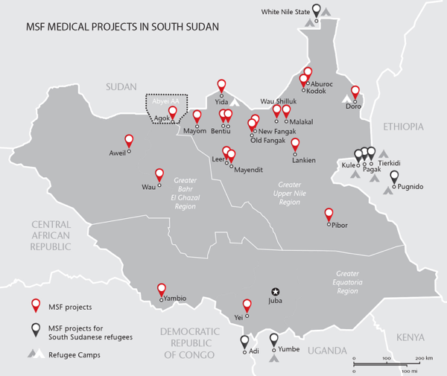
The actors: MSF France
One surgical project in South Sudan:
Aweil State Hospital
150-beds
250-300 surgical procedures/month
Rotating expat surgeons
Notes:
Explain MSF: 1971, surgery since 1983. 100k surgical procedures/ 250k deliveries per year.

Slide 7
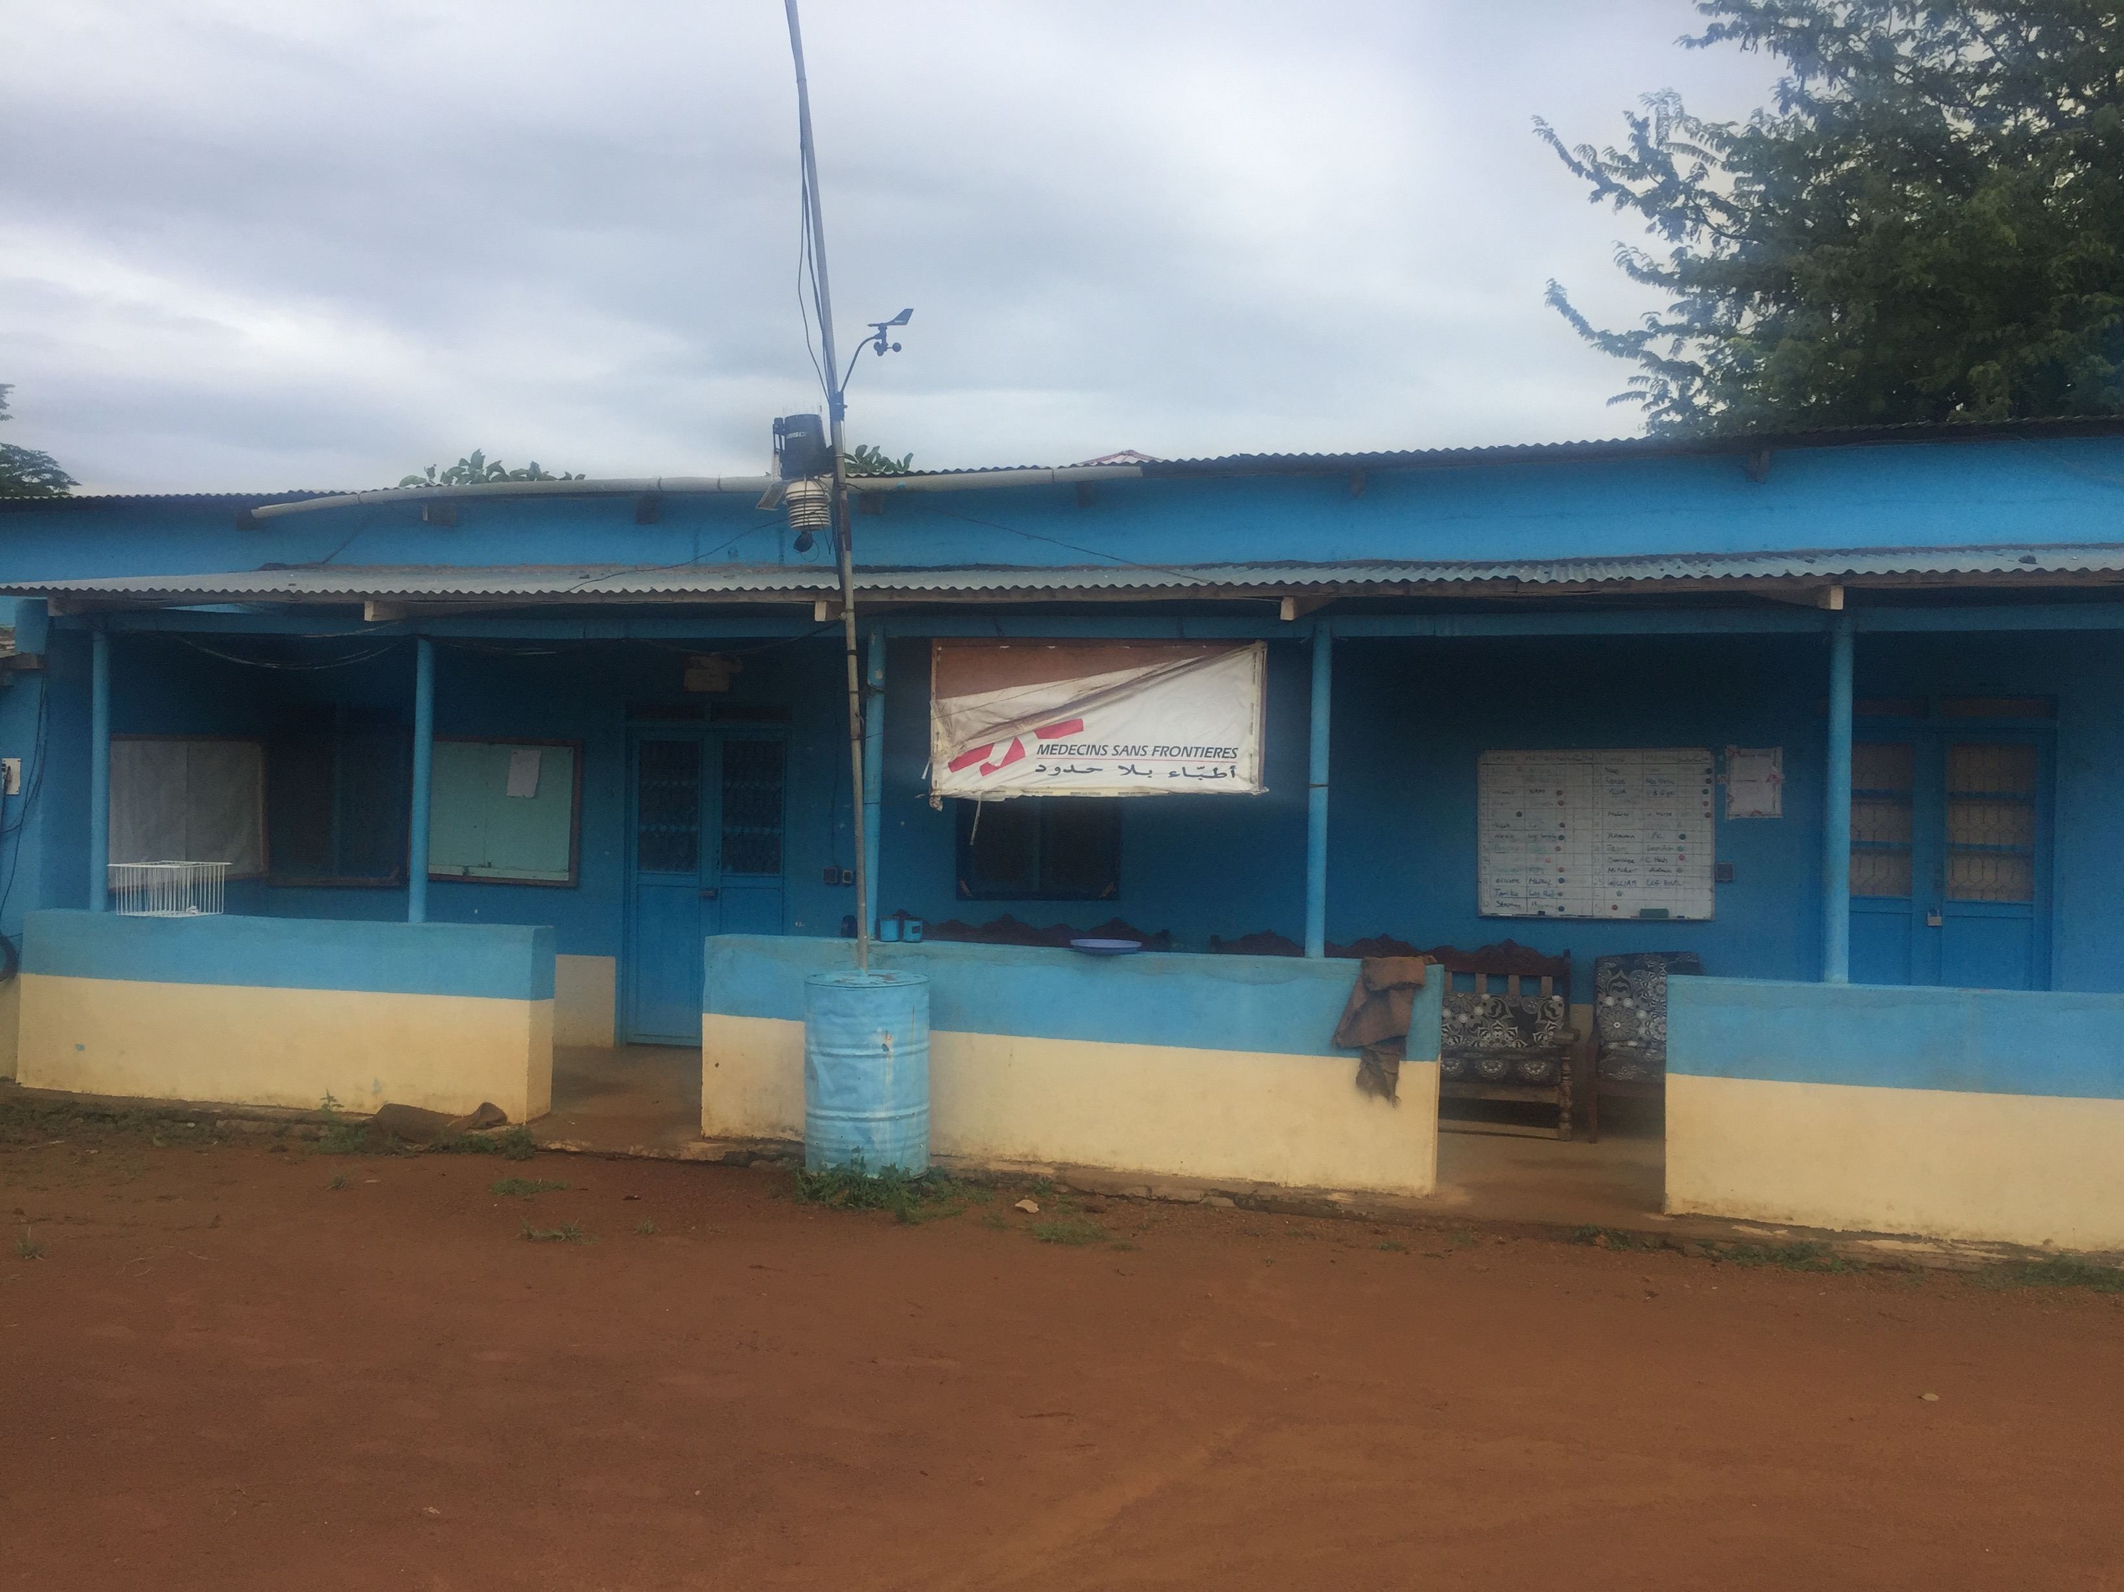

Slide 8
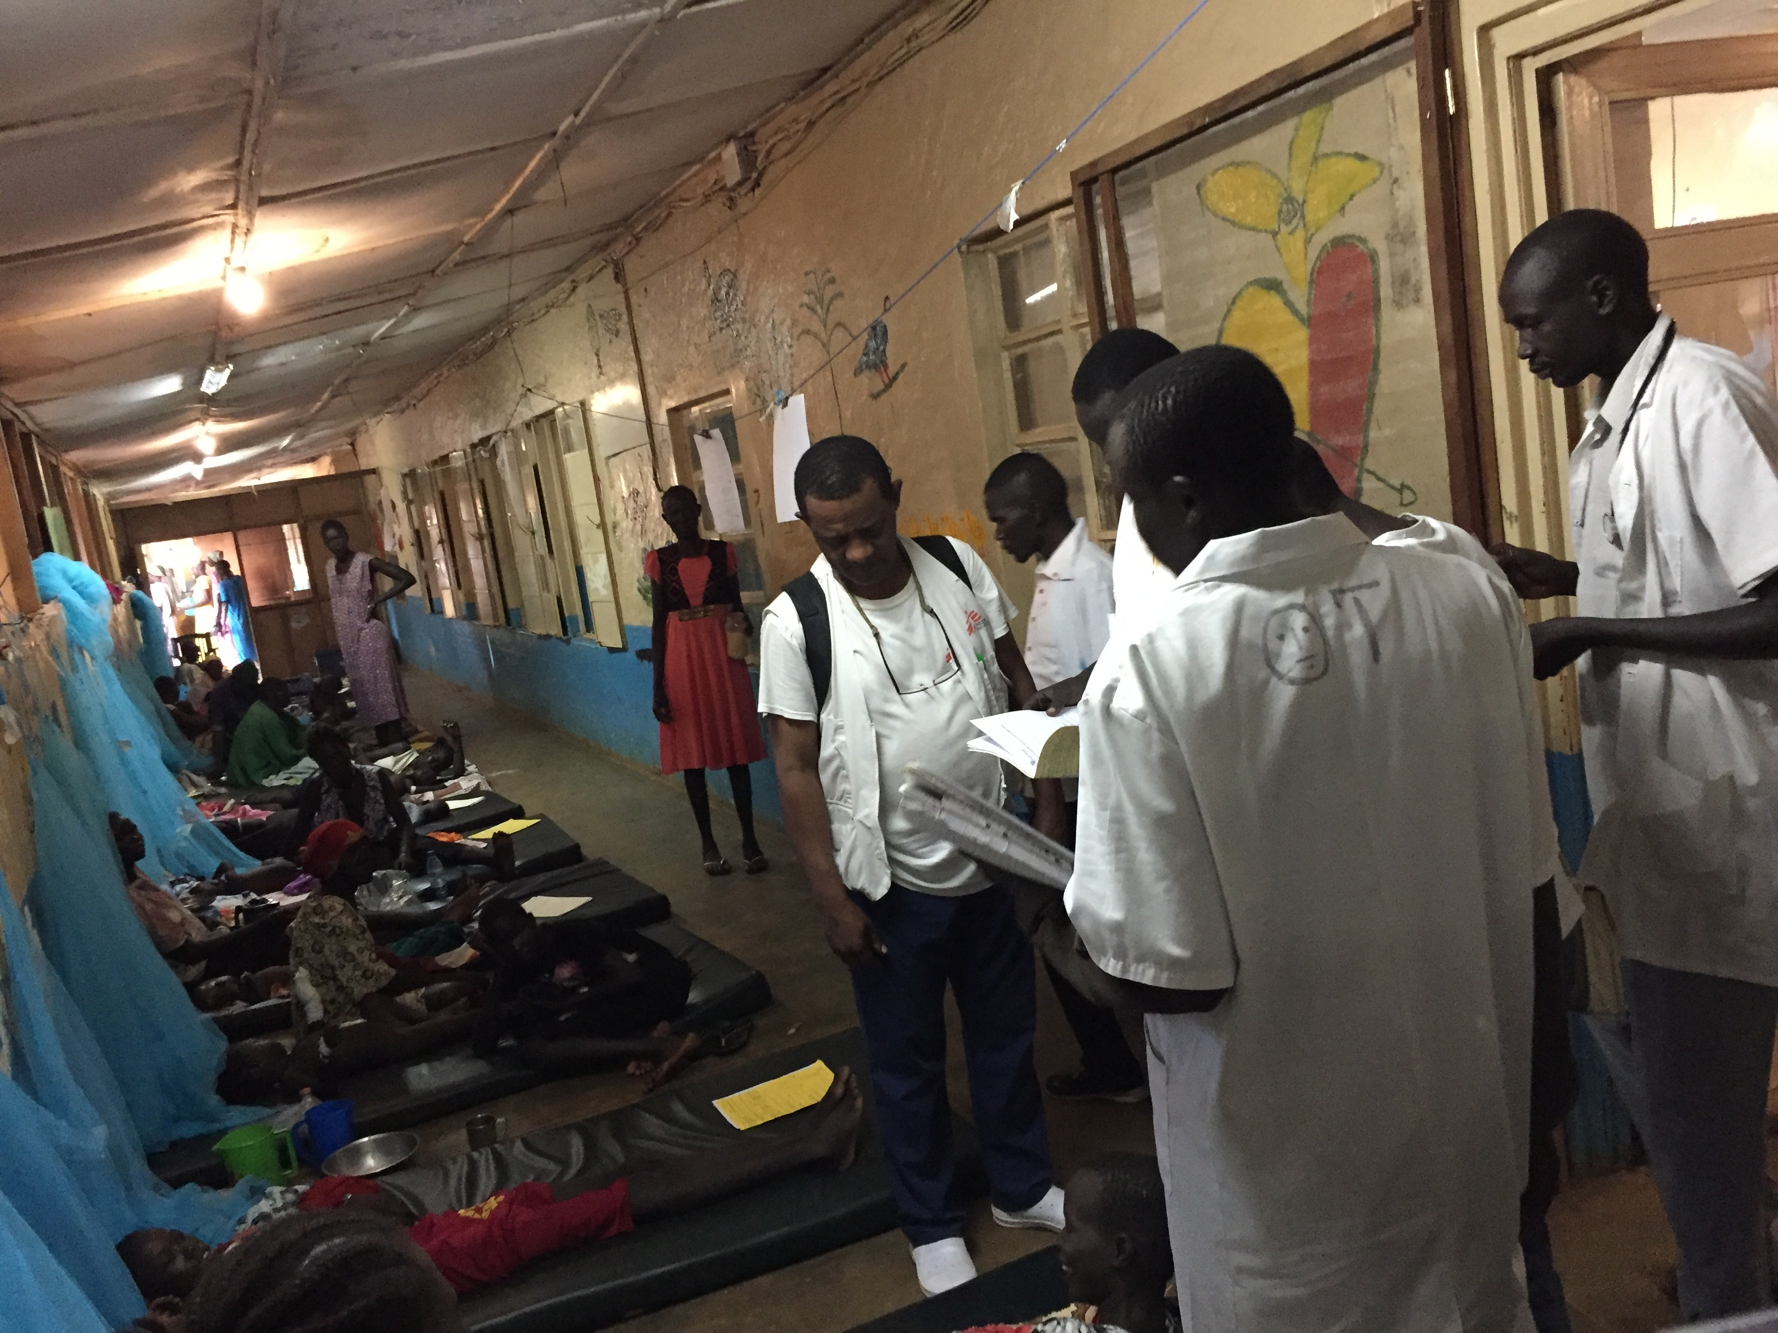

Slide 9
The actors: UBC
Branch for International Surgical Care: pool of experienced surgical faculty from different specialties and disciplines
Launched Masters in Global Surgical Care (MGSC) in 2018 [3]
Experience in capacity-building projects
Experience in multi-sectoral partnerships
Links to Enhanced Surgical Skills Program in Canada
[3] https://internationalsurgery.med.ubc.ca/masters-program/
Notes:
BISC: since 2003
Pool UBC : 23 per specialty, 20 in total, can access resources of the surgical dept. Incl. OT nurses
Masters in GSC: online, 2 years full time, 7 courses , one practicum (field), 19 students total, degree: MGSC
UBC engaged in trauma training (DSTC, ASSET, mini fellowship) and telementoring (Revelstoke)

Slide 11
The concept
Task-sharing program
Cost-effective
Improves retention [4]
Proposed duration 12-24months
Modular e-learning curriculum with online evaluations
Technical skills taught in the field following CBD principles
Field visits by specialist MSF and UBC surgeons
[4] Pereira C, Cumbi A, Malalane R, Vaz F, McCord C, Bacci A, Bergstro ̈m S. Meeting the need for emergency obstetric care in Mozambique:
work performance and histories of medical doctors and assistant medical officers trained for surgery. BJOG 2007;114:1530–1533.
Notes:
In Mozambique, none of the graduates from three medical school classes sent to a rural hospital was still there after 7 years. Of the TCs who were assigned to the same category of hospitals directly after graduation, 88% stayed at least that long.
scope: limited, bellweather procedures plus: burns, pediatrics ?, basic trauma incl. DCS Laparotomie, airway, sterilzation, save surgery…
Modulare e-learning eval: 80% correct to pass
Remy might go
ideally 4 visits a year for two weeks

Slide 12
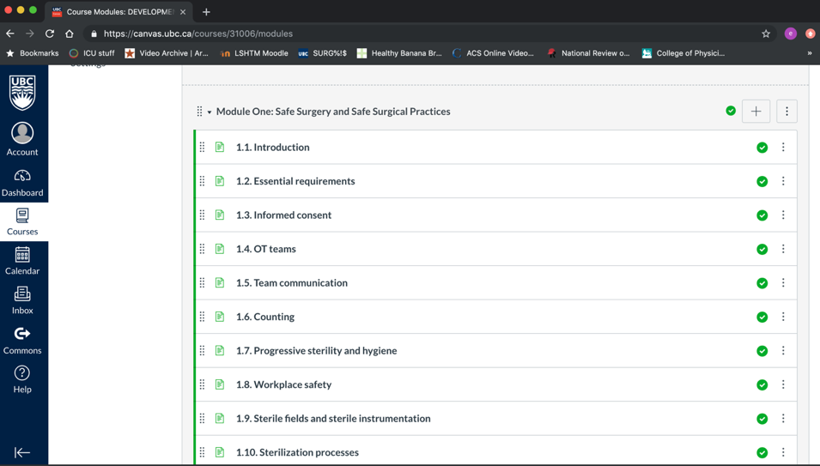
Notes:
8 modules, along the DCP3 list of essential surgical package. Plus context-relevant procedures: ex - peds

Slide 13
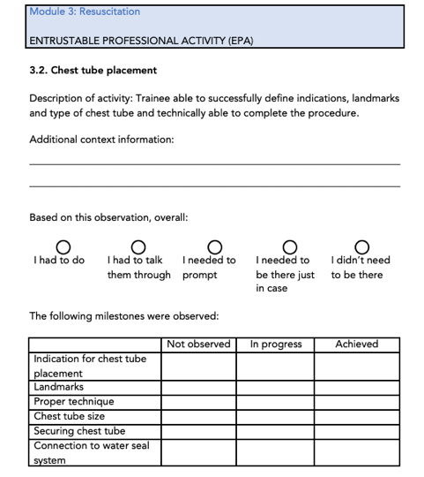
Competence by design
Breaks up medical education into Entrustable Professional Activities (EPA) [5]
Reproducible
Transparent
Promotes accountability
[5] http://www.royalcollege.ca/rcsite/cbd/rationale-why-cbd-e
Notes:
The benefits of focusing on learning instead of time
Ensures competence, but teaches for excellence
Supports physicians’ skills and abilities to evolve throughout practice — enhancing care
Responds to changing patient and societal needs
Addresses gaps in the current system, like the “failure to fail” culture of resident education
Reduces burden on faculties, promoting smoother credentialing and accreditation
Increases accountability and promotes transparency in training

Slide 14
The application
Launched in Aweil July 2019
3 trainees enrolled (Medical Officers)
First 4 months: completed 2/8 modules
MSF surgeon-trainer deployed for 12 months to maintain continuity
Visits: 1 UBC anesthetist x 6weeks; 1 MSF plastic surgeon x 1week
Upcoming: visit by UBC faculty, review of EPAs
Notes:
Finished med school then 1-2y internship
Remy is supposed to go December for the burns module
two year commitment as per contract

Slide 15
The pitfalls
Local buy-in/network creation:
Stakeholder engagement: Ministry of Health and Ministry of Education
Trainee retention
Partners buy-in:
UBC faculty (motivation, sustainability, availability)
Quality of training:
Selection of trainers
Mid to long-term program evaluation
Maintenance of competency
Scope of practice
Notes:
could be a trainee survey sent at 6-12-245months post training. already submitted program monitoring and evaluation concept note to MSF-OCP to measure quantitative data (surgical procedures, patient outcomes).

Slide 16
Outlook
Technical oversight (MSF Working Groups, BISC, UBC Division of General Surgery, ESS group)
Links with other training initiatives (MSF and non-MSF related)
Can be / needs to be up-scaled !
6 other MSF surgical projects in SSA
Parallel between this project and ESS curriculum in Canada?

Slide 17
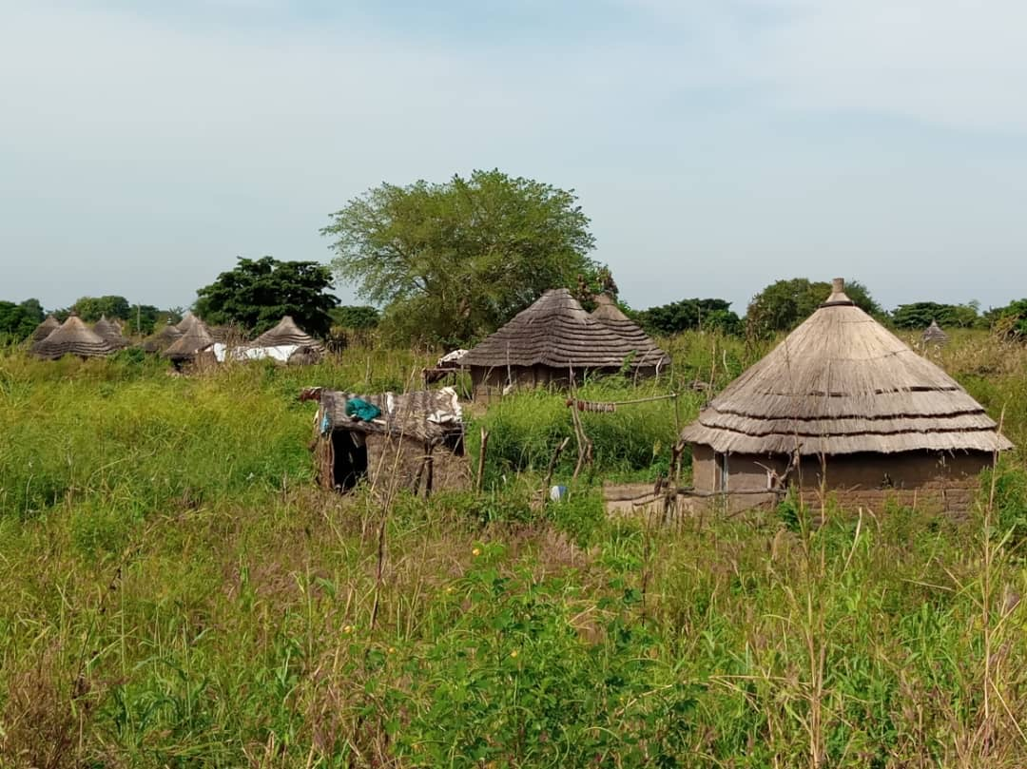
Thank you!!

